Slide 1

Do randomised controlled trials need a theory?
Dr Andi Fugard (they/them)
a.fugard@bbk.ac.uk

Slide 2
The plan for this video
Ditch ontology
Show how to use randomised experiments to test social change
Criticise randomisation
Defend it
Criticise assumptions of randomised experiments
Sneak ontology in again through mechanisms

Slide 3
ACTION
“The philosophers have only interpreted the world, in various ways; the point is to change it.”
(Karl Marx, 1845)
“The point is not to interpret whiteness but to abolish it.”
(Noel Ignatiev, 1997)

Slide 4
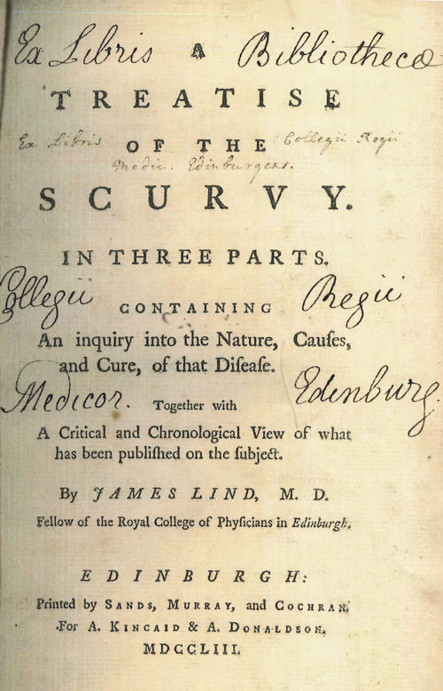
James Lind (1753)
www.jameslindlibrary.org/lind-j-1753/

Slide 5
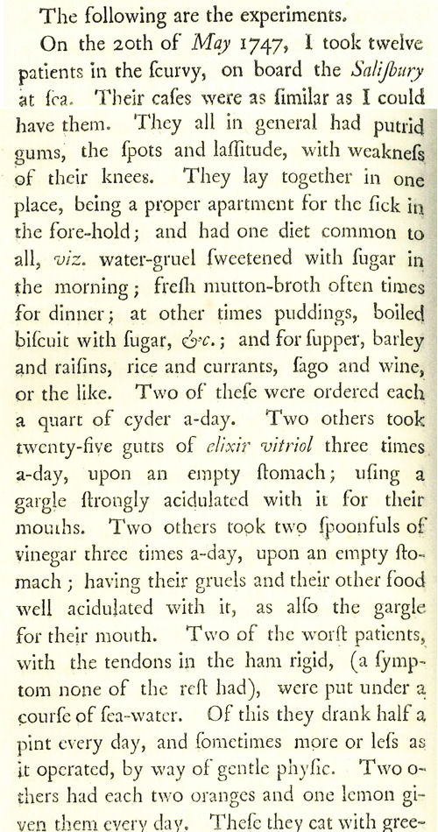
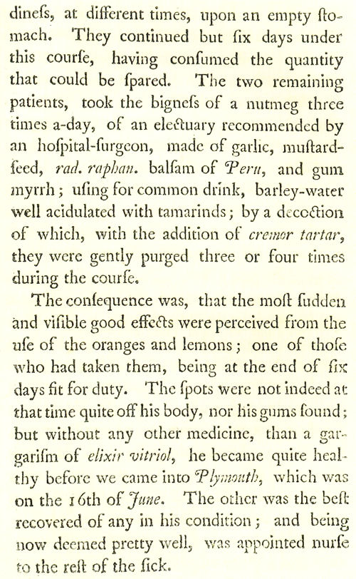

Slide 6
Participants
“On the 20th May, 1747, I took twelve patients in the scurvy on board the Salisbury at sea. Their cases were as similar as I could have them. They all in general had putrid gums, the spots and lassitude, with weakness of their knees. They lay together in one place, being a proper apartment for the sick in the fore-hold; and had one diet in common to all, viz., water gruel sweetened with sugar in the morning; fresh mutton broth often times for dinner; at other times puddings, boiled biscuit with sugar etc.; and for supper barley, raisins, rice and currants, sago and wine, or the like.”

Slide 7
Each group had two participants
“ordered each a quart of cyder a day”
“twenty five gutts of elixir vitriol three times a day upon an empty stomach, using a gargle strongly acidulated with it for their mouths.”
“two spoonfuls of vinegar three times a day upon an empty stomach”
“a course of sea water”
“two oranges and one lemon given them every day. These they eat with greediness”

Slide 8
Final group
“The two remaining patients took the bigness of a nutmeg three times a day of an electuray recommended by an hospital surgeon made of garlic, mustard seed, rad. raphan., balsam of Peru and gum myrrh, using for common drink narley water well acidulated with tamarinds, by a decoction of wich, with the addition of cremor tartar, they were gently purged three or four times during the course”

Slide 9
Results
“The consequence was that the most sudden and visible good effects were perceived from the use of the oranges and lemons”
…
“Next to the oranges, I thought the cyder had the best effects”

Slide 10
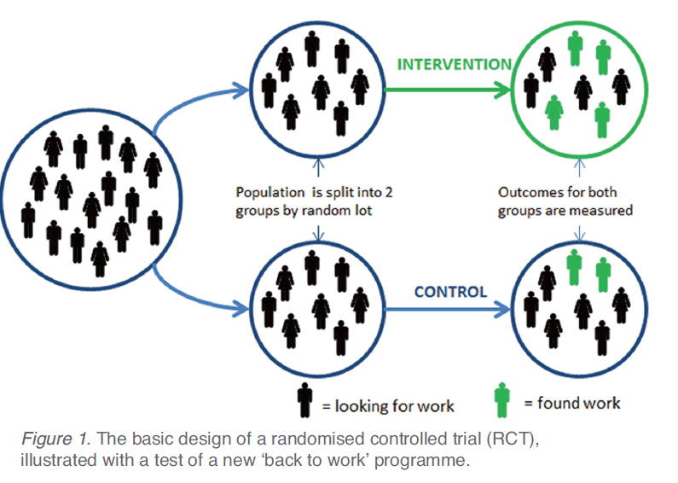
(Test, Learn, Adapt)

Slide 11
How it works
Identify policies to compare
Identify intended outcome
Decide on randomisation unit
Determine how many units required
Randomise units to policies
Measure results
Adapt policy based on findings and go to 1

Slide 12
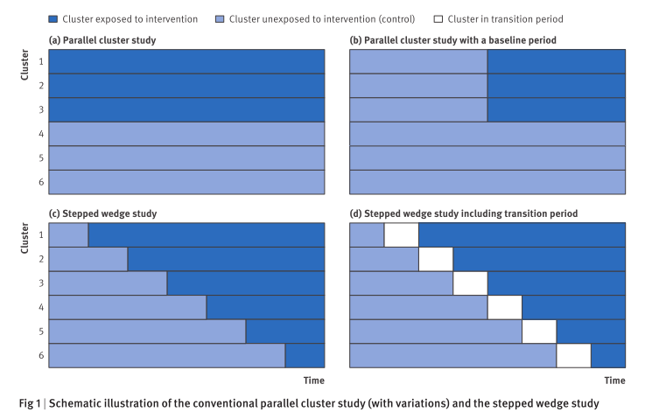
Karla Hemming et al. (2015). The stepped wedge cluster randomised trial: rationale, design, analysis, and reporting. BMJ, 350, h391.

Slide 13
Case series
Expert opinion
Individual cohort study
Individual RCT
SR of RCTs
Case control study
Systematic review (SR) of case control studies
Outcomes research/ecological studies
SR of cohort studies
“All-or-none”
Levels of evidence – drawn from Centre for Evidence-based Medicine, Oxford http://www.cebm.net/index.aspx?o=1025

Slide 14
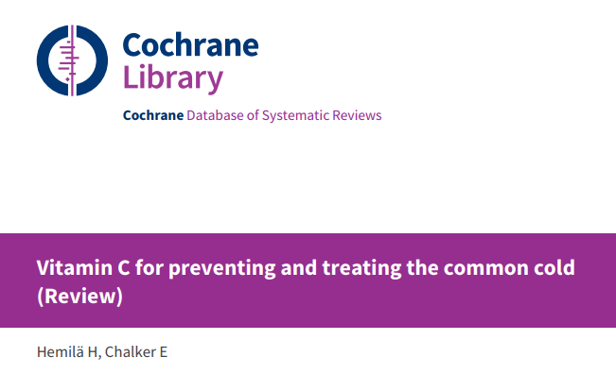

Slide 15
Worrall versus randomisation
“… it is […] impossible to match for all possible “confounding” factors. At most we can match for all the “known” (possibly) confounding factors. […] There is, however, clearly an indefinite number of unknown factors that might play a causal role.”

Slide 16
La Caze et al. versus Worall
“It is not necessary for the purpose of issuing a probability statement to know the value of unmeasured covariates; it is sufficient to know their distribution in probability, which randomisation is designed to provide.”
“Similar knowledge regarding unmeasured covariates is not possible in observational designs.”

Slide 17
Nancy Cartright (2010)
“The RCT is neat because it allows us to learn causal conclusions without knowing what the possible confounding factors actually are.”

Slide 18
Problems if…
You know the group you’re in – which affects expectations
The control group is unethical, e.g., less money and participants are in poverty
There’s an average benefit to the “treatment” group but things are worse for some sub-groups

Slide 19
Drug trials – placebos hard there too!
Study of droperidol vs. lorazepam vs. placebo
“… it's absolutely mind-bogglingly obvious to anybody after an hour whether or not they are taking an antipsychotic or a placebo – the side effects are so marked. There is no such thing as a placebo antipsychotic…”
Richard Bentall psychologist and study participant
http://www.nzherald.co.nz/nz/news/article.cfm?c_id=1&objectid=10565099

Slide 20
What you want
Run some randomised trials
Show they worked
Be confident the results will transfer to a larger target population

Slide 21
Internal vs. external validity
Even if randomisation improves confidence about internal validity…
Study sample isn’t necessarily representative of your target population – convenience samples common
Policy might not work when the research team leaves, even if it is representative

Slide 22
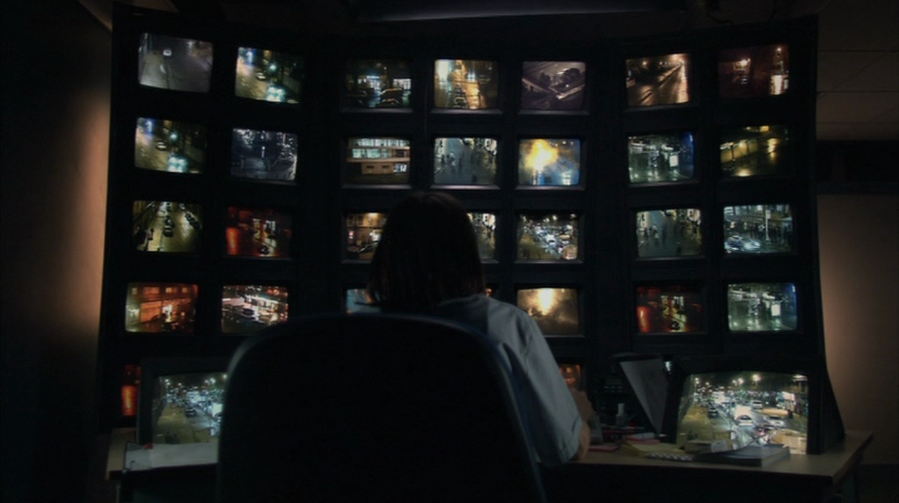
Does CCTV reduce crime?
Red Road (2006)

Slide 23
How might CCTV reduce crime? Car park example
Offenders will be caught & stopped
Deters potential offenders
CCTV → sense of safety → more people around → “natural” surveillance
Effective deployment of police to right areas
Fewer long-duration crimes based on estimates of police/security response
Potential victims reminded that area high risk, so take more precautions
Selection bias: CCTV-heavy car parks attract people who are otherwise cautious

Slide 24
Russo and Williamson (2007)
“In order to establish that A is a cause of B in medicine one normally needs to establish two things. First, that A and B are suitably correlated—typically, that A and B are probabilistically dependent, conditional on B’s other known causes. Second, that there is some underlying mechanism linking A and B that can account for the difference that A makes to B.”

Slide 25
Phyllis Illari & Jon Williamson (2011)
Mechanisms:
“A mechanism for a phenomenon consists of entities and activities organized in such a way that they are responsible for the phenomenon.”

Slide 26
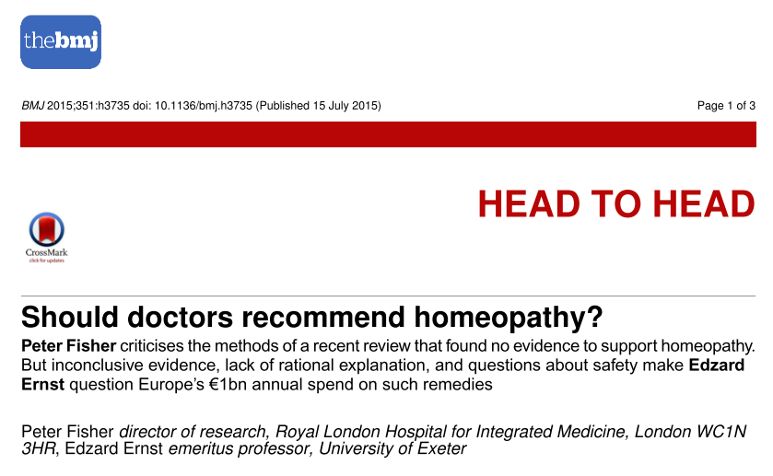

Slide 27
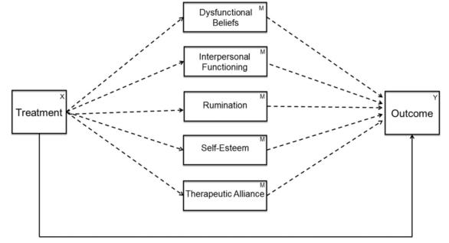
Can the mechanism be more quant data?
Lemmens, et al. (2017). Exploring mechanisms of change in cognitive therapy and interpersonal psychotherapy for adult depression. Behaviour Research and Therapy, 94, 81–92. http://doi.org/10.1016/j.brat.2017.05.005

Slide 28
Where are the mechanisms (quotes from Sonia Dalkin. et al., 2015)
Archer: “collective, constrained decision making is the underlying mechanism that creates all social outcomes”
Bhaskar: power and resources “lie with great institutional forms of society”
Pawson and Tilley: “human reasoning” (reasoning → behaviour from their perspective)

Slide 29
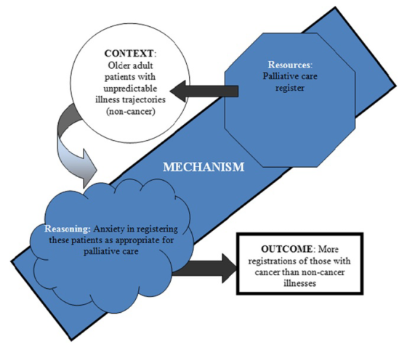
Sonia Dalkin. et al., 2015

Slide 30
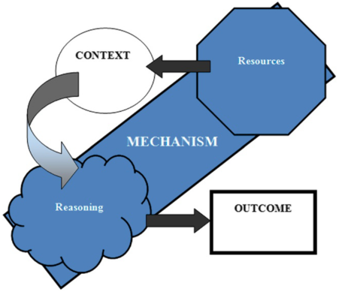
Sonia Dalkin. et al., 2015

Slide 31
To ponder…
Where do we get ideas from for the mechanisms and processes…?

Slide 32

Summary
a.fugard@bbk.ac.uk

